Slide 1
CSE5095-002: Topics in Software Defined Networking
Lecture 8
Minmei Wang
Computer Science and Engineering
Some slides are borrowed from P4 tutorials.

Slide 2
Outlines
What is data plane programming
Introduction to P4
P4 runtime
Resources

Slide 3
What is Data Plane Programming?
Why program the Data Plane?
Copyright © 2018 – P4.org
2

Slide 4


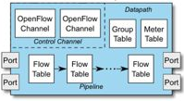

Software Defined Networking: Logically Centralized Control
Main contributions
OpenFlow = standardized model
match/action abstraction
OpenFlow = standardized protocol to interact with switch
download flow table entries, query statistics, etc.
Concept of logically centralized control via a single entity (“SDN controller”)
Simplifies control plane – e.g. compute optimal paths at one location (controller), vs. waiting for distributed routing algorithms to converge
Issues
Data-plane protocol evolution requires changes to standards (12 → 40 OpenFlow match types)
Limited interoperability between vendors => southbound I/F differences handled at controller (OpenFlow / netconf / JSON / XML variants)
Control Function (“App”) x m
Northbound I/F
SDN
Controller
x 1
Southbound I/F
x n
Switch
Copyright © 2018 – P4.org
3

Slide 5




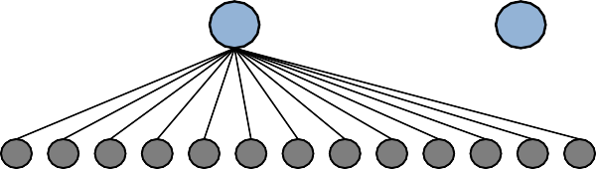






Status Quo: Bottom-up design
Switch OS
?
Network Demands
Run-time API
Driver
“This is how I know to process packets”
(i.e. the ASIC datasheet makes the rules)
Copyright © 2018 – P4.org
Fixed-function ASIC
4

Slide 6










A Better Approach: Top-down design
Switch OS
Network Demands
Feedback
Run-time API
Driver
P4
“This is how I want the network to behave and how to switch packets…”
(the user / controller makes the rules)
P4 Programmable Device
Copyright © 2018 – P4.org
5

Slide 7
Benefits of Data Plane Programmability
New Features – Add new protocols
Reduce complexity – Remove unused protocols
Efficient use of resources – flexible use of tables
Greater visibility – New diagnostic techniques, telemetry, etc.
SW style development – rapid design cycle, fast innovation, fix data plane bugs in the field
You keep your own ideas
Think programming rather than protocols…
Copyright © 2018 – P4.org

Slide 8
Programmable Network Devices
PISA: Flexible Match+Action ASICs
Intel Flexpipe, Cisco Doppler, Cavium (Xpliant), Barefoot Tofino, …
NPU
EZchip, Netronome, …
CPU
Open Vswitch, eBPF, DPDK, VPP (vector packet processor)…
eBPF: Berkeley Packet Filter: packet analysis
FPGA
Xilinx, Altera, …
These devices let us tell them how to process packets.
Copyright © 2018 – P4.org

Slide 9
What can you do with P4?
Layer 4 Load Balancer – SilkRoad[1]
Low Latency Congestion Control – NDP[2]
In-band Network Telemetry – INT[3]
Fast In-Network cache for key-value stores – NetCache[4]
Consensus at network speed – NetPaxos[5]
Aggregation for MapReduce Applications [6]
Network measurement tasks – PINT [7]
Distributed machine learning – SwitchML [8], ATP [9]
… and much more
[1] Miao, Rui, et al. "SilkRoad: Making Stateful Layer-4 Load Balancing Fast and Cheap Using Switching ASICs." SIGCOMM, 2017.
[2] Handley, Mark, et al. "Re-architecting datacenter networks and stacks for low latency and high performance.” SIGCOMM, 2017.
[3] Kim, Changhoon, et al. "In-band network telemetry via programmable dataplanes.” SIGCOMM. 2015.
[4] Xin Jin et al. “NetCache: Balancing Key-Value Stores with Fast In-Network Caching.” To appear at SOSP 2017
[5] Dang, Huynh Tu, et al. "NetPaxos: Consensus at network speed.” SIGCOMM, 2015.
[6] Sapio, Amedeo, et al. "In-Network Computation is a Dumb Idea Whose Time Has Come." Hot Topics in Networks. ACM, 2017.
[7] Ben Basat, Ran, et al. PINT: Probabilistic in-band network telemetry, In Proc. of ACM SIGCOMM, 2020.
[8] Sapio, Amedeo, et al. "Scaling distributed machine learning with in-network aggregation." in Proc. of USENIX NSDI 2021.
[9] Lao, ChonLam, et al. "{ATP}: In-network Aggregation for Multi-tenant Learning.“ in Proc. of USENIX NSDI 2021.
Copyright © 2018 – P4.org

Slide 10
Brief History and Trivia
May
July
Aug
Sep
Jan
Mar
Nov
May
Apr
Dec
May
2013:
2014:
2014:
2014:
2015:
2015:
2016:
2017:
Initial idea and the name “P4” First paper (SIGCOMM CCR)
First P4₁₄ Draft Specification (v0.9.8) P4₁₄ Specification released (v1.0.0) P4₁₄ v1.0.1
P4₁₄ v1.0.2 P4₁₄ v1.0.3 P4₁₄ v1.0.4
P4₁₆ – first commits
First P4₁₆ Draft Specification P4₁₆ Specification released
2016:
2016:
2017:
Copyright © 2018 – P4.org

Slide 11
Introduction to P4

Slide 12
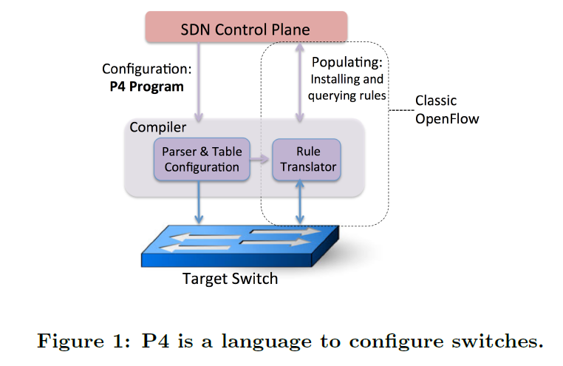
P4
P4 is a higher-level language for Programming Protocol-independent Packet Processors

Slide 13
















PISA: Protocol-Independent Switch Architecture
Programmer defines the tables and the exact processing algorithm
Programmer declares how the output packet will look on the wire
Programmer declares the headers that should be recognized and their order in the packet
Programmable Match-Action Pipeline
Programmable Deparser
Programmable Parser
Copyright © 2018 – P4.org

Slide 14


















PISA in Action
Packet is parsed into individual headers (parsed representation)
Headers and intermediate results can be used for matching and actions
Headers can be modified, added or removed
Packet is deparsed (serialized)
Programmable Match-Action Pipeline
Programmable Parser
Programmable Deparser
Copyright © 2018 – P4.org

Slide 15
















P4₁₆ Language Elements
Parsers
State machine, bitfield extraction
Controls
Tables, Actions, control flow statements
Expressions
Basic operations and operators
Data Types
Bistrings, headers, structures, arrays
Architecture Description
Programmable blocks and their interfaces
Extern Libraries
Support for specialized components
Copyright © 2018 – P4.org

Slide 16
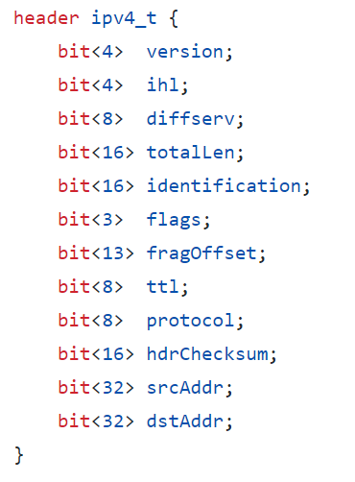
Parsers
Parsers describe the permitted sequences of headers within received packets

Slide 17
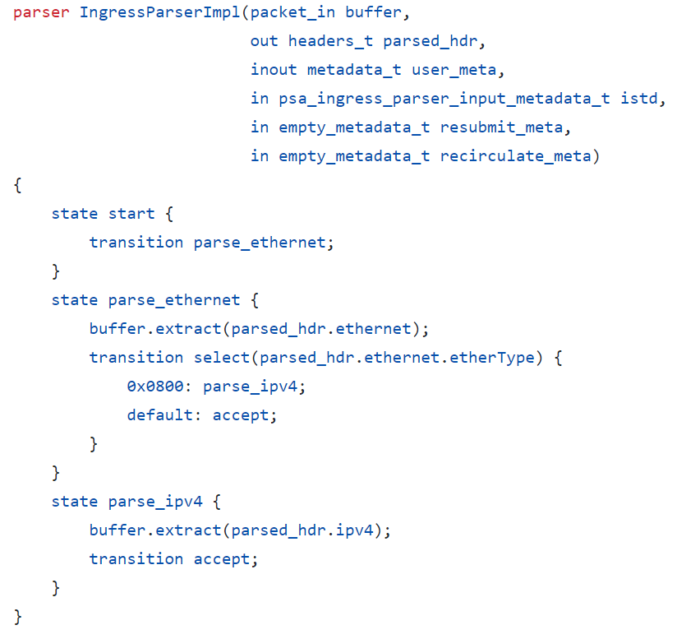
Parsers
Parsers describe the permitted sequences of headers within received packets

Slide 18
Controls - Tables
The fundamental unit of a Match-Action Pipeline
Specifies what data to match on and match kind
Specifies a list of possible actions
Optionally specifies a number of table properties
Size
Default action
Static entries
etc.
Each table contains one or more entries (rules)
An entry contains:
A specific key to match on
A single action that is executed when a packet matches the entry
Action data (possibly empty)
Copyright © 2018 – P4.org
35

Slide 19










Tables: Match-Action Processing
Control Plane
Headers and Metadata
Directional (DataPlane) Parameters
Lookup Key
Hit
Key | Action ID | Action Data
Action Code
Action ID
Hit/Miss
Selector
Directionless (Action Data) Parameters
Data
Headers and Metadata (Input)
Default Action ID
Default Action Data
Headers and Metadata (Output)
Action Execution
Copyright © 2018 – P4.org

Slide 20


Example: IPv4_LPM Table
Data Plane (P4) Program
Defines the format of the table
Key Fields
Actions
Action Data
Performs the lookup
Executes the chosen action
Control Plane (IP stack,
10.0.1.1
10.0.1.2
Key | Action | Action Data
10.0.1.1/32 | ipv4_forward | dstAddr=00:00:00:00:01:01 port=1
10.0.1.2/32 | drop
*` | NoAction
Routing protocols)
Populates table entries with specific information
Based on the configuration
Based on automatic discovery
Based on protocol calculations
Copyright © 2018 – P4.org

Slide 21

IPv4_LPM Table
table ipv4_lpm { key = {
hdr.ipv4.dstAddr: lpm;
}
actions = { ipv4_forward; drop; NoAction;
}
size = 1024;
default_action = NoAction();
}
Copyright © 2018 – P4.org

Slide 22

Match Kinds
/* core.p4 */ match_kind {
exact, ternary, lpm
}
/* v1model.p4 */ match_kind {
range,
selector
}
/* Some other architecture */ match_kind {
regexp, fuzzy
}
The type match_kind is special in P4
The standard library (core.p4) defines three standard match kinds
Exact match
Ternary match
LPM match
The architecture (v1model.p4) defines two additional match kinds:
range
selector
Other architectures may define (and provide implementation for) additional match kinds
Copyright © 2018 – P4.org
Selector: dynamic action selection

Slide 23

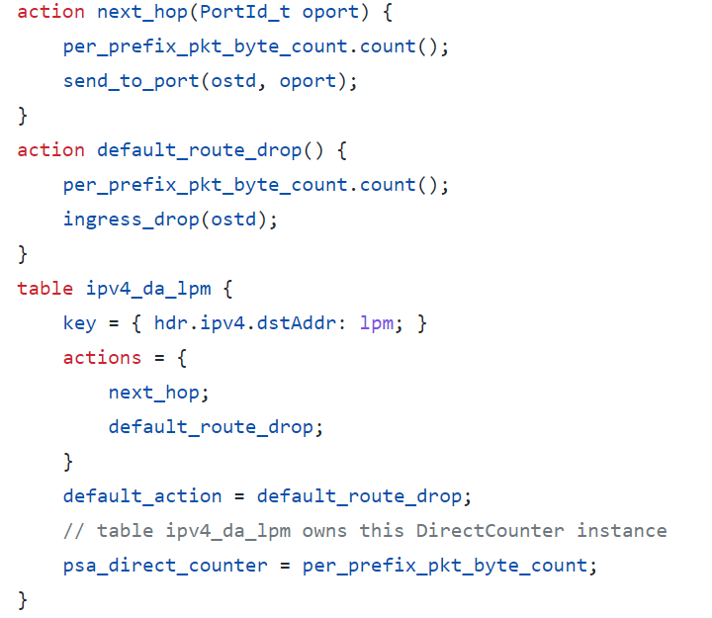
Defining Actions for L3 forwarding
/* core.p4 */ action NoAction() {
}
/* basic.p4 */ action drop() {
mark_to_drop();
}
/* basic.p4 */
action ipv4_forward(macAddr_t dstAddr,
bit<9> port) {
...
}
Copyright © 2018 – P4.org

Slide 24
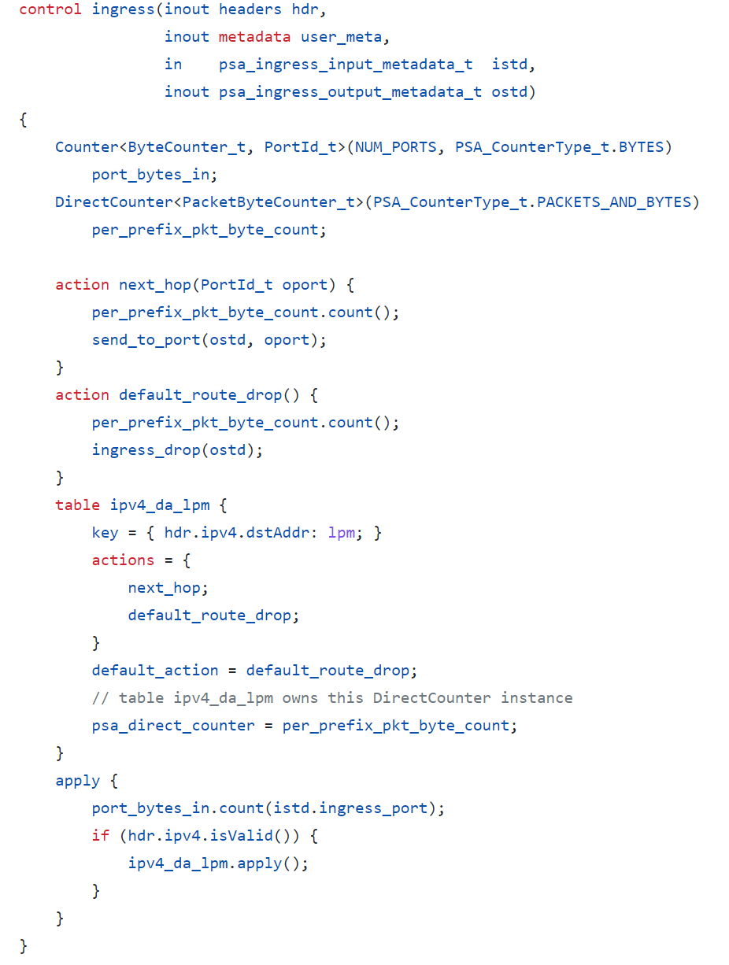
Controls
Control flow
Describes packet-processing
steps on a target

Slide 25

Applying Tables in Controls
control MyIngress(inout headers hdr,
inout metadata meta,
inout standard_metadata_t standard_metadata) {
table ipv4_lpm {
...
}
apply {
...
ipv4_lpm.apply();
...
}
}
Copyright © 2018 – P4.org

Slide 26
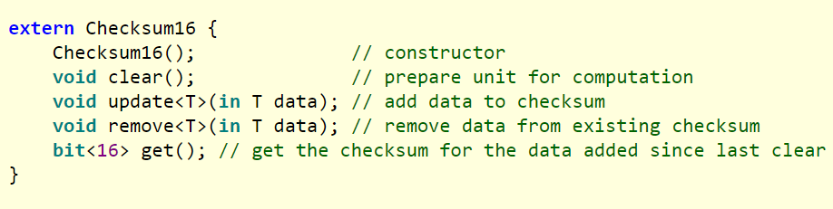
Extern objects and functions
P4 programs can also interact with objects and functions provided by the architecture
extern construct describes the interfaces exposed to the data plane
Checksum operations offered by an incremental checksum unit

Slide 27

P4₁₆ Deparsing
/* From core.p4 */ extern packet_out {
void emit<T>(in T hdr);
}
/* User Program */
control DeparserImpl(packet_out packet,
in headers hdr) {
apply {
...
packet.emit(hdr.ethernet);
...
}
}
Assembles the headers back into a well-formed packet
Expressed as a control function
No need for another construct!
packet_out extern is defined in core.p4: emit(hdr): serializes header if it is valid
Advantages:
Makes deparsing explicit...
...but decouples from parsing
Copyright © 2018 – P4.org

Slide 28








P4_16 Approach
Term | Explanation
P4 Target | An embodiment of a specific hardware implementation
P4 Architecture | Provides an interface to program a target via some set of P4-programmable components, externs, fixed components
Community-Developed
Vendor-supplied
P4₁₆
Language
P4₁₆ Core
Extern Libraries
Architecture Definition
Library
Copyright © 2018 – P4.org

Slide 29


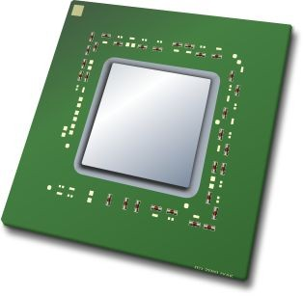







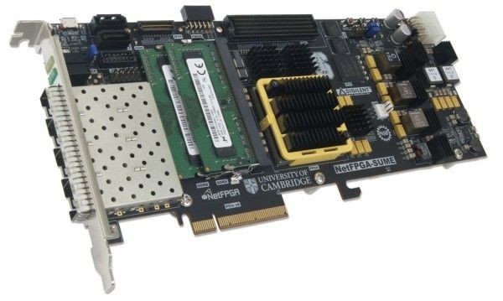














Example Architectures and Targets
V1Model (BMv2 Simple Switch)
TM
SimpleSumeSwitch
TM
Portable Switch Architecture (PSA)
TM
Anything
Copyright © 2018 – P4.org
15
The SimpleSumeSwitch is the P4 architecture that is currently defined for the NetFPGA SUME.
As an analogy, the PSA is to the P4₁₆ language as the C standard library is to the C programming language.

Slide 30
V1 model
Load balance based on ECMP
https://github.com/p4lang/tutorials/blob/master/exercises/load_balance/solution/load_balance.p4

Slide 31
Tips for writing P4 code
V1 model
https://github.com/p4lang/p4c/blob/main/p4include/v1model.p4

Slide 32
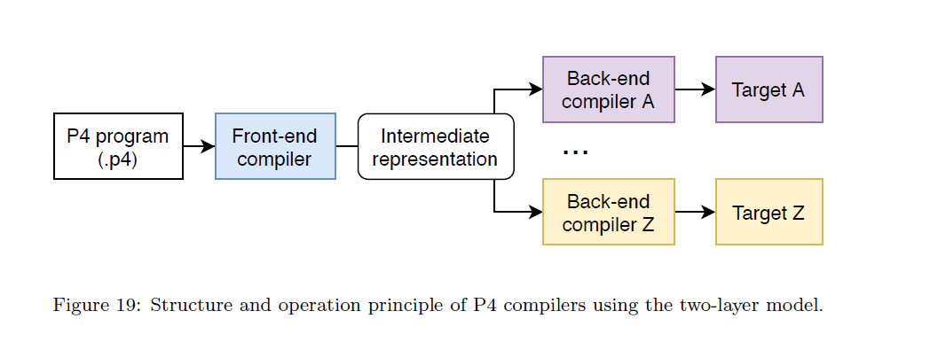
P4 compiler

Slide 33
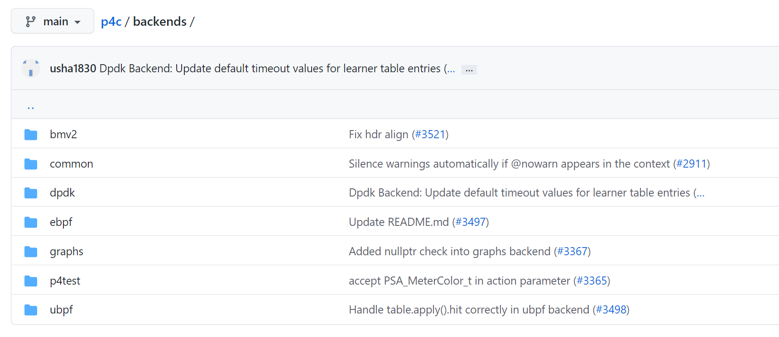
P4 compiler
https://github.com/p4lang/p4c/tree/main/backends

Slide 34
P4Runtime
8

Slide 35














Runtime control of P4 data planes
User supplied
Control Plane
P4 Program
P4 Compiler
Add/remove table entries
Extern control
Packet-in/out
P4 Architecture Model
CPU port
Target-specific configuration binary
Extern objects
Data Plane
Load
Tables
Focus of this session
Vendor supplied
Copyright © 2018 – P4.org, ONF
9

Slide 36
What is P4Runtime?
Framework for runtime control of P4 targets
Open-source API + server implementation
https://github.com/p4lang/PI
Initial contribution by Google and Barefoot
Work-in-progress by the p4.org API WG
Protobuf-based API definition
p4runtime.proto
gRPC transport
P4 program-independent
API doesn’t change with the P4 program
13

Slide 37
Protocol Buffers (protobuf) Basics
Language for describing data for serialization in a structured way
Common binary wire-format
Language-neutral
Code generators for: Action Script, C, C++, C#, Clojure, Lisp, D, Dart, Erlang, Go, Haskell, Java, Javascript, Lua, Objective C, OCaml, Perl, PHP, Python, Ruby, Rust, Scala, Swift, Visual Basic, ...
Platform-neutral
Extensible and backwards compatible
Strongly typed
Copyright © 2018 – P4.org, ONF
14

Slide 38
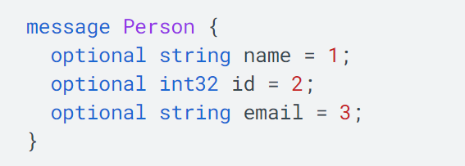
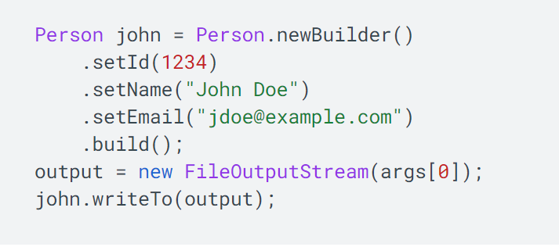
Protocol Buffers (protobuf) Basics
14

Slide 39
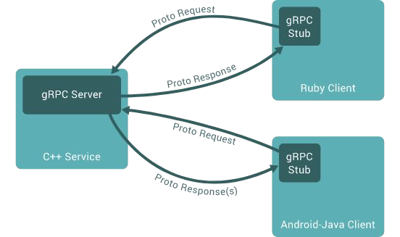
gRPC Basics
Use Protocol Buffers to define service API and messages
Automatically generate native stubs in:
C / C++
C#
Dart
Go
Java
Node.js
PHP
Python
Ruby
Transport over HTTP/2.0 and TLS
Efficient single TCP connection implementation that supports bidirectional streaming
Copyright © 2018 – P4.org, ONF
15
More details here: https://grpc.io/docs/guides/

Slide 40
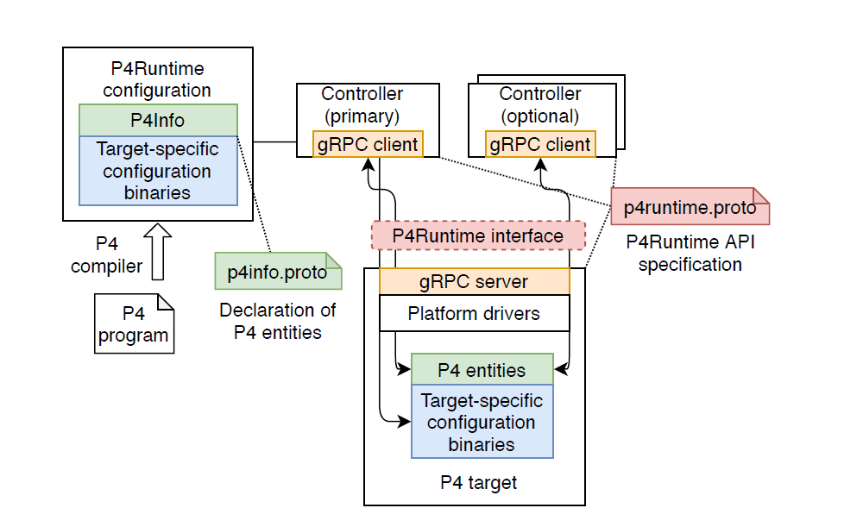
What is P4Runtime?
13

Slide 41
P4Runtime Service
Enables a local or remote entity to arbitrate mastership, load the pipeline/program, send/receive packets, and read and write forwarding table entries, counters, and other P4 entities.
service P4Runtime {
rpc Write(WriteRequest) returns (WriteResponse) {}
rpc Read(ReadRequest) returns (stream ReadResponse) {}
rpc SetForwardingPipelineConfig(SetForwardingPipelineConfigRequest) returns (SetForwardingPipelineConfigResponse) {}
rpc GetForwardingPipelineConfig(GetForwardingPipelineConfigRequest) returns (GetForwardingPipelineConfigResponse) {}
rpc StreamChannel(stream StreamMessageRequest) returns (stream StreamMessageResponse) {}
}
Copyright © 2018 – P4.org, ONF
17

Slide 42
P4Runtime Service
P4Runtime Protobuf Definition:
https://github.com/p4lang/p4runtime/blob/master/proto/p4/v1/p4runtime.proto
Service Specification:
https://p4.org/p4-spec/p4runtime/main/P4Runtime-Spec.html
Copyright © 2018 – P4.org, ONF
18

Slide 43

P4Info example
basic_router.p4
basic_router.p4info
...
action ipv4_forward(bit<48> dstAddr,
bit<9> port) {
/* Action implementation */
}
...
table ipv4_lpm { key = {
hdr.ipv4.dstAddr: lpm;
}
actions = {
ipv4_forward;
...
}
...
}
actions {
id: 16786453
name: "ipv4_forward" params {
id: 1
name: "dstAddr" bitwidth: 48
...
id: 2
name: "port" bitwidth: 9
}
}
...
tables {
id: 33581985
name: "ipv4_lpm" match_fields {
id: 1
name: "hdr.ipv4.dstAddr" bitwidth: 32
match_type: LPM
}
action_ref_id: 16786453
}
P4 compiler
22

Slide 44








Local control
Same target-independent protobuf format
table_entry { table_id: 33581985 match {
field_id: 1 lpm {
value: "\f\000\... prefix_len: 8
}
}
action {
action_id: 16786453 params {
param_id: 1 value: "\000\0...
}
params { param_id: 2
value: 7
}
}
}
OSPF
BGP
P4-defined protocol
etc.
Local control plane
p4info
p4info
P4 target
The P4Runtime API can be used equally well by a remote or local control plane
Copyright © 2018 – P4.org, ONF
29

Slide 45









Remote control
table_entry { table_id: 33581985 match {
field_id: 1 lpm {
value: "\f\000\... prefix_len: 8
}
}
action {
action_id: 16786453 params {
param_id: 1 value: "\000\0...
}
params { param_id: 2
value: 7
}
}
}
Target-independent protobuf format
P4-defined custom protocol
OSPF
BGP
etc.
p4info
Remote control plane
p4info
p4info
p4info
Vendor A
Vendor B
Vendor C
Copyright © 2018 – P4.org, ONF
28

Slide 46
Behavior model
BM runtime API
Command line interface (CLI) program to manipulate MATs
https://github.com/p4lang/behavioral-model
List of supported commands
table_set_default <table name> <action name> <action parameters>
table_add <table name> <action name> <match fields> => <action parameters> [priority]
table_delete <table name> <entry handle>

Slide 47
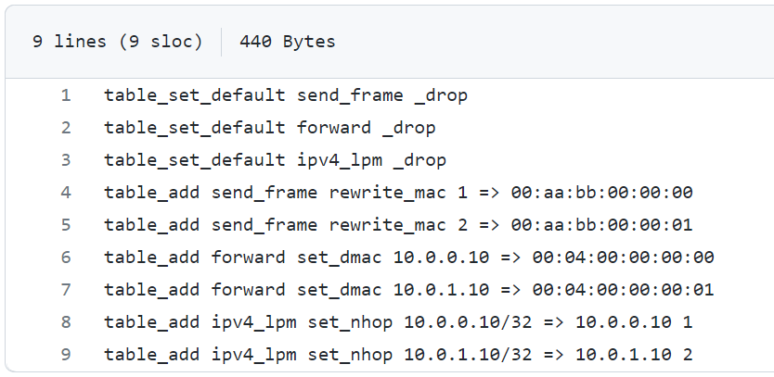
Behavior model
BM runtime API
Command line interface (CLI) program to manipulate MATs
https://github.com/p4lang/behavioral-model
Simple router

Slide 48
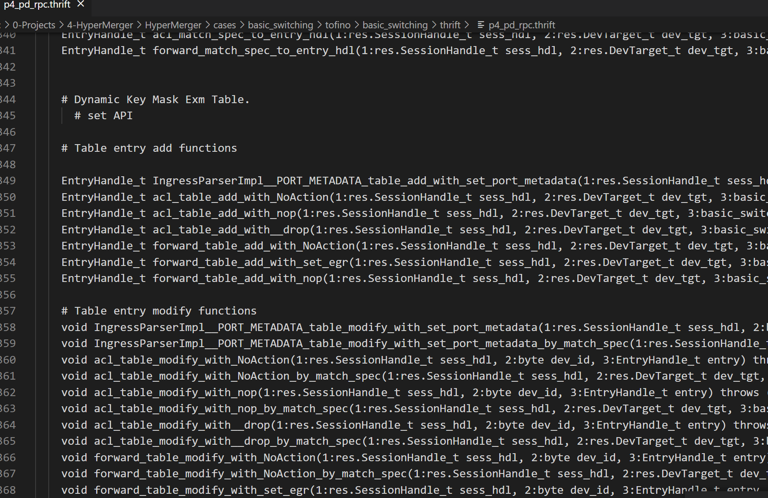
Barefoot runtime interface
BfRt API
C, C++, Python

Slide 49

Resources and platform
Behavioral model (BMv2 simple switch)
A tool for developing, testing, and debugging P4 data planes and control plane software
https://github.com/p4lang/behavioral-model
https://github.com/p4lang/tutorials
Run using VirtualBox
Hardware switch
E.g., Tofino Switch
Intel ICRP

Slide 50

Resources and platform
ICRP
https://github.com/barefootnetworks/Open-Tofino

Slide 51
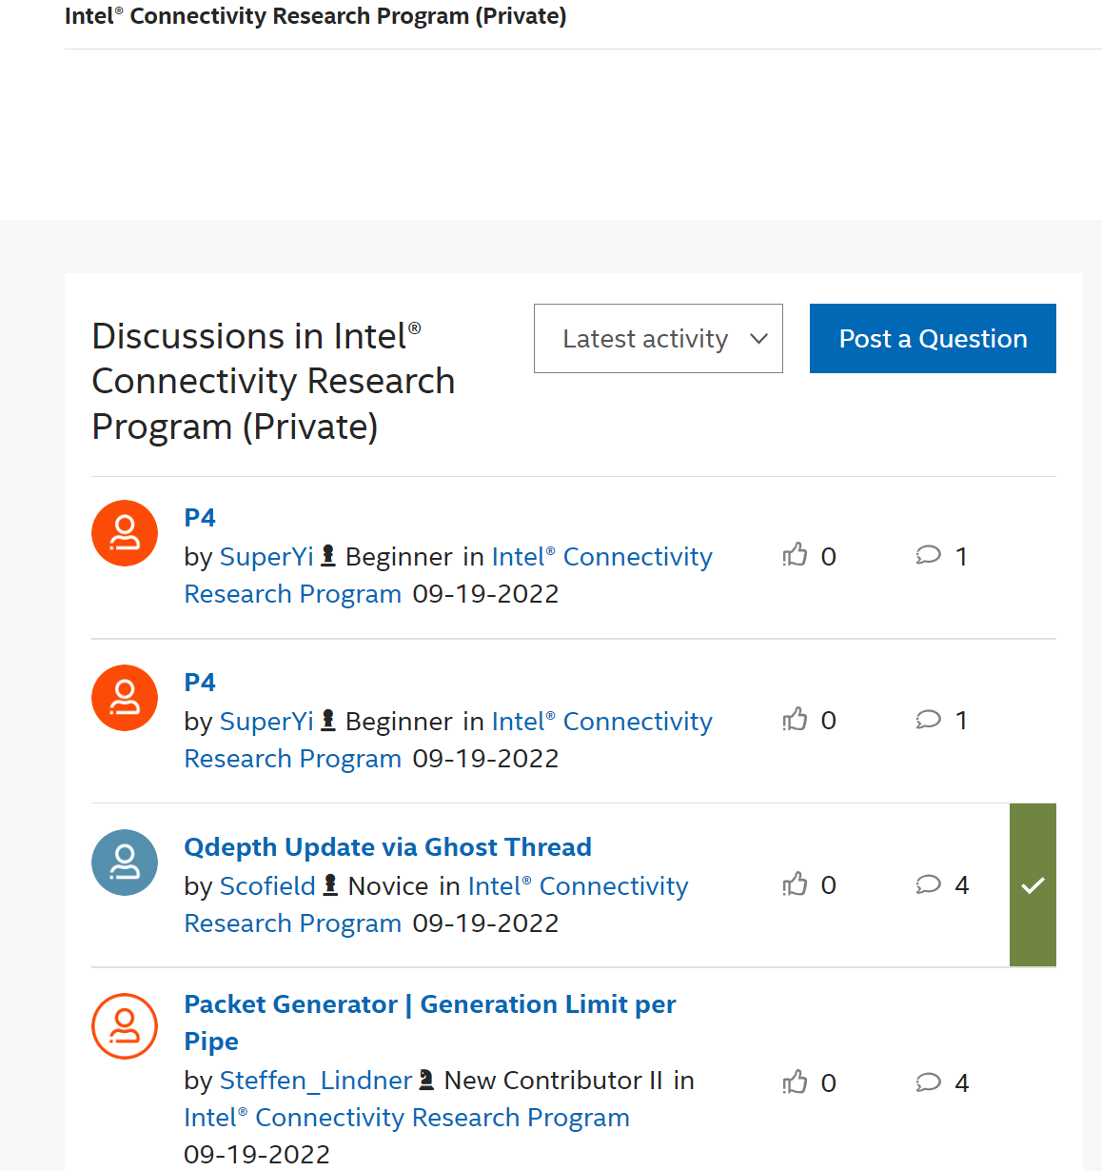
Resources and platform
https://github.com/barefootnetworks/Open-Tofino

